Slide 1
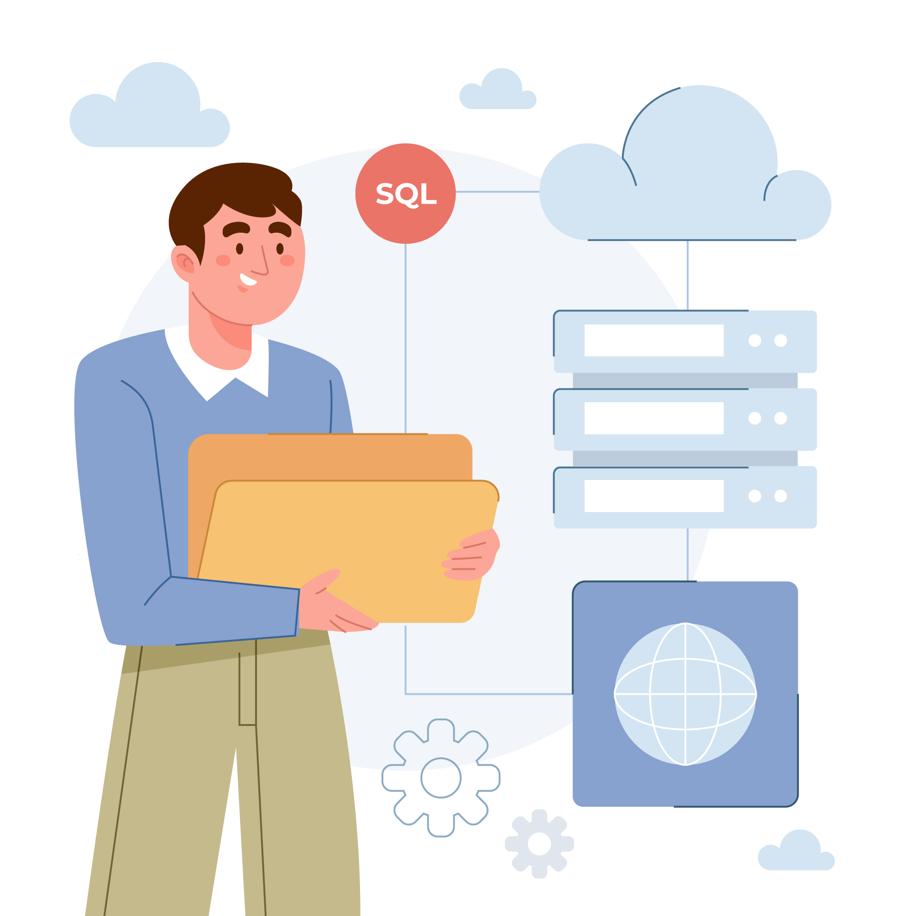
ORM
(Object Relational Mapping)

Slide 2


ORM(Object Relational Mapping)
Object Relational Mapping (ORM) is a technique used in creating a "bridge" between object-oriented programs and, in most cases, relational databases.
While using SQL for this purpose isn't necessarily a bad idea, the ORM and ORM tools help simplify the interaction between relational databases and different OOP languages.

Slide 3

What is an ORM Tool?
An ORM tool is software designed to help OOP developers interact with relational databases.
Here's an example of SQL code that retrieves information about a particular Job from a database:
“select Title,Discription From Job where id=10”
On the other hand, an ORM tool can do the same query as above with simpler methods.ie
Jobs.GetbyId(10)

Slide 4
Popular ORM Tools for .NET
Entity Framework:Entity Framework is a multi-database object-database mapper. It supports SQL, SQLite, MySQL, PostgreSQL, and Azure Cosmos DB.
NHibernate:NHibernate is an open source object relational mapper with tons of plugins and tools to make development easier and faster.
Dapper:Dapper is a micro-ORM. It is mainly used to map queries to objects. This tool doesn't do most of the things an ORM tool would do like SQL generation, caching results, lazy loading, and so on.
Base One Foundation Component Library (BFC):BFC is a framework for creating networked database applications with Visual Studio and DBMS software from Microsoft, Oracle, IBM, Sybase, and MySQL

Slide 5


Advantages and Disadvantages of Using ORM Tools
It speeds up development time for teams.
Decreases the cost of development.
Handles the logic required to interact with databases.
Improves security. ORM tools are built to eliminate the possibility of SQL injection attacks.
You write less code when using ORM tools than with SQL.
Learning how to use ORM tools can be time consuming.
They are likely not going to perform better when very complex queries are involved.
ORMs are generally slower than using SQL.

Slide 6

ENTITY FRAMEWORK
Entity Framework is an object-relational mapper (O/RM) that enables .NET developers to work with a database using .NET objects. It eliminates the need for most of the data-access code that developers usually need to write.

Slide 7
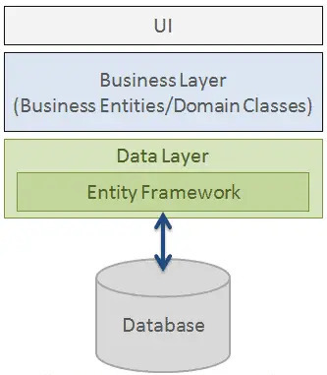
Structure:
As per the above figure, Entity Framework fits between the business entities (domain classes) and the database. It saves data stored in the properties of business entities and also retrieves data from the database and converts it to business entities objects automatically.

Slide 8

Entity Framework Features
Cross-platform
Modelling:
Querying
Change Tracking:
Saving:
Caching:
Built-in Conventionas:
Concurrency:
Configurations:
Migrations:
Transactions:
Entity FrameWork

Slide 9
Entity Framework Core
Entity Framework Core is the new version of Entity Framework after EF 6.x. It is open-source, lightweight, extensible and a cross-platform version of Entity Framework data access technology.
Entity Framework is an Object/Relational Mapping (O/RM) framework. It is an enhancement to ADO.NET that gives developers an automated mechanism for accessing & storing the data in the database.
EF Core is intended to be used with .NET Core applications. However, it can also be used with standard .NET 4.5+ framework based applications.

Slide 10
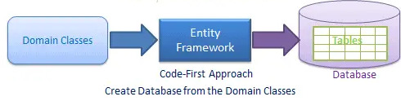
EF Core Development Approaches
EF Core supports two development approaches
1)Code-First:In the code-first approach, EF Core API creates the database and tables using migration based on the conventions and configuration provided in your domain classes. This approach is useful in Domain Driven Design (DDD).

Slide 11
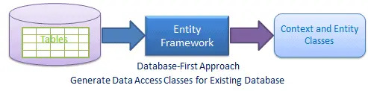
Database-First:In the database-first approach, EF Core API creates the domain and context classes based on your existing database using EF Core commands. This has limited support in EF Core as it does not support visual designer or wizard.

Slide 12

Install Entity Framework Core
EF Core is not a part of .NET Core and standard .NET framework. It is available as a NuGet package. You need to install NuGet packages for the following two things to use EF Core in your application:
1.EF Core DB provider
2.EF Core tools

Slide 13
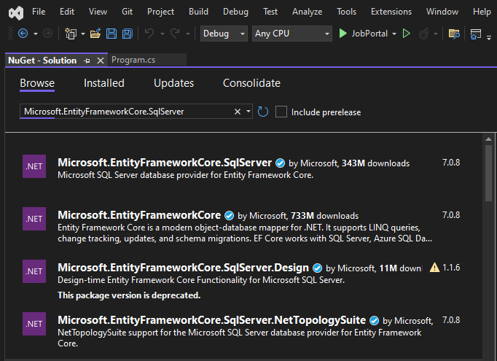
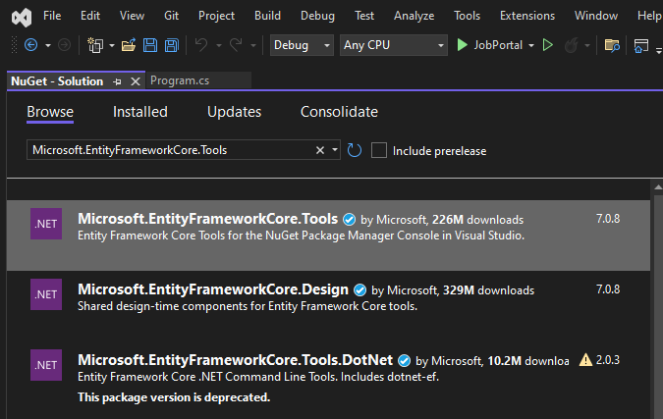
EF Core DB provider and Tool is installed by NuGet Package manager:

Slide 14
Creating a Model for an Existing Database in Entity Framework Core
Reverse engineering command creates entity and context classes (by deriving DbContext) based on the schema of the existing database.
Scaffold-DbContext command. This reverse engineering command creates entity and context classes (by deriving DbContext) based on the schema of the existing database.The following parameters can be specified with Scaffold-DbContext in Package Manager Console:
Scaffold-DbContext [-Connection] [-Provider] [-OutputDir] [-Context] [-Schemas>][-Tables>][-DataAnnotations][-Force][-Project][-StartupProject] [<CommonParameters>]

Slide 15
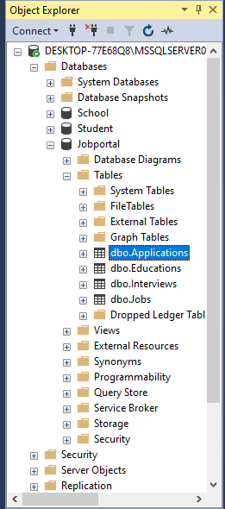
Excersise:
Create entity and context classes for the following Jobportal database

Slide 16

PM>Scaffold-DbContext Server=.\SQLExpress; Database=; Trusted_Connection=True;" Microsoft.EntityFrameworkCore.SqlServer -OutputDir Models
DB Server: Server=.\SQLExpress;
Database name :JobPoratal
Security info:Trusted_Connection=True;
SQLServer provider : Microsoft.EntityFrameworkCore.SqlServer.
-OutputDir :Directory where we want to generate all the classes which is the Model

Slide 17
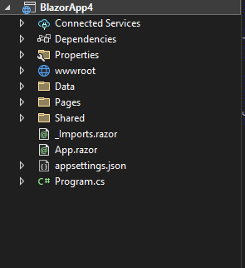
Example:
Scaffold-DbContext command creates entity classes for each table in the SchoolDB database and context class (by deriving DbContext) with Fluent API configurations for all the entities in the Models folder.

Slide 18
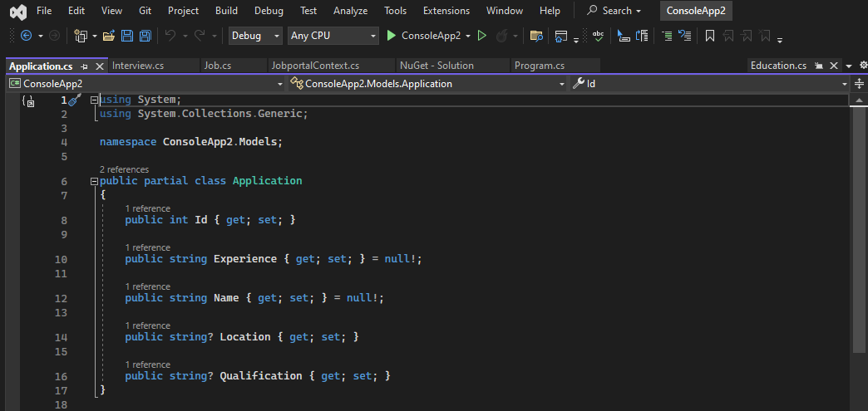
Example:
The following is the generated Application entity class for the Application table.

Slide 19
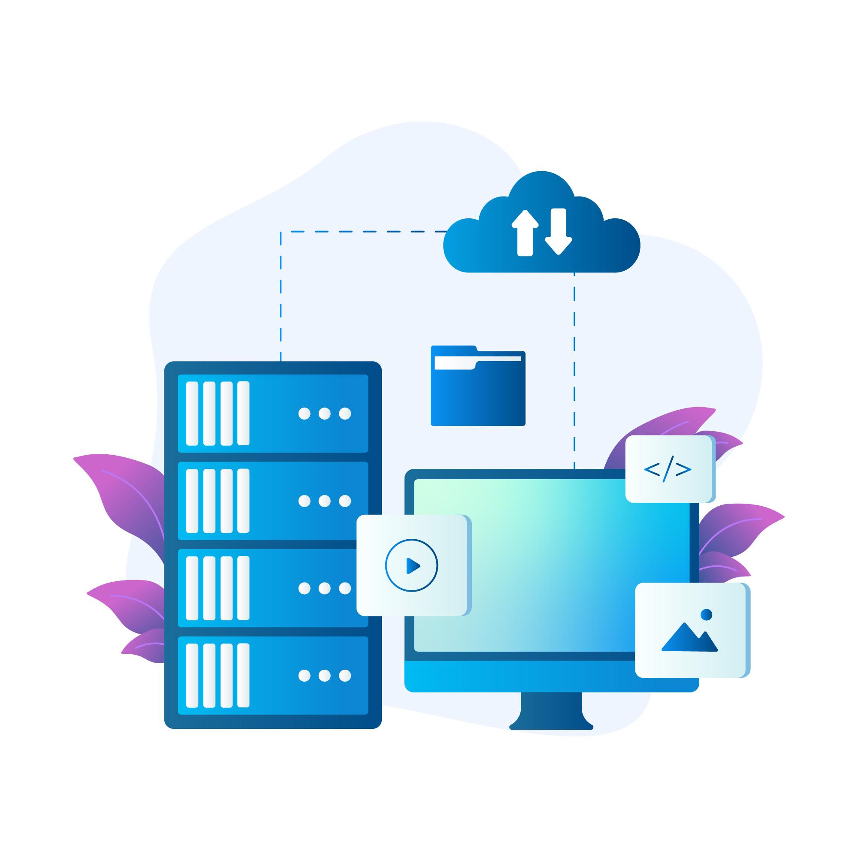
Entity Framework Core: DbContext
The DbContext class is an integral part of Entity Framework.
An instance of DbContext represents a session with the database which can be used to query and save instances of your entities to a database.

Slide 20

DbContext in EF Core allows us to perform following tasks:
Manage database connection
Configure model & relationship
Querying database
Saving data to the database
Configure change tracking
Caching
Transaction management
This context class typically includes DbSet<TEntity> properties for each entity in the model.

Slide 21
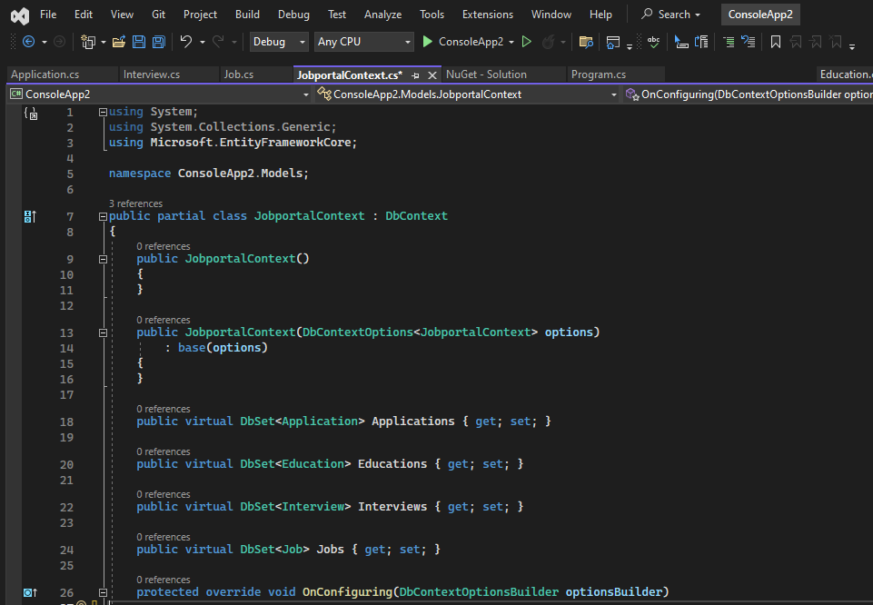
Example:
The following is the JobportalContext class which you can use to save or retrieve data.
In the example above, the JobportalContext class is derived from the DbContext class and contains the DbSet<TEntity> properties of Applications, Educations ,Interviews and Jobs type.

Slide 22
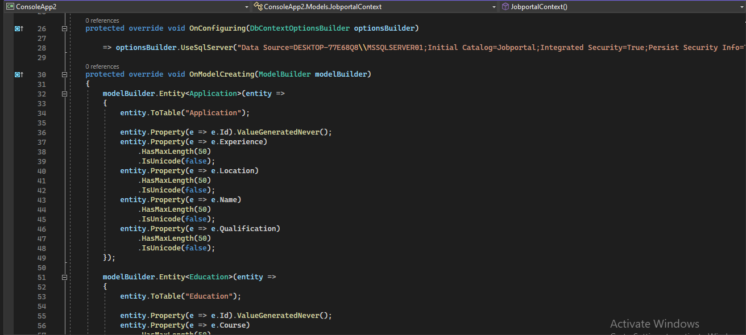
OnConfiguring():method allows us to select and configure the data source to be used with a context using DbContextOptionsBuilder.
OnModelCreating():method allows us to configure the model using ModelBuilder Fluent API.

Slide 23
Code First Approach
Domain of your application and start creating classes for your domain entity rather than design your database first and then create the classes which match your database design.
Create/Modify Domain Classes
Automated/Code Based Migration
Configure Domain Classes
Database

Slide 24
Creating the Model
Entity Framework needs to have a model (Entity Data Model) to communicate with the underlying database. It builds a model based on the shape of your domain classes, the Data Annotations and Fluent API configurations.
The EF model includes three parts:
1.Conceptual model:Builds based on your domain classes (entity classes), the context class and configurations
2. storage model:Builds based on the Provider we use.
3. Mapping between the conceptual and storage models.

Slide 25
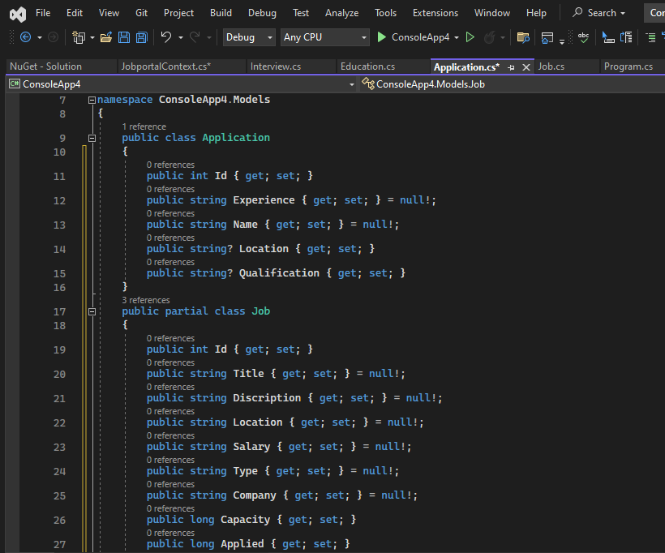
Here the Classes for the Application and Job

Slide 26
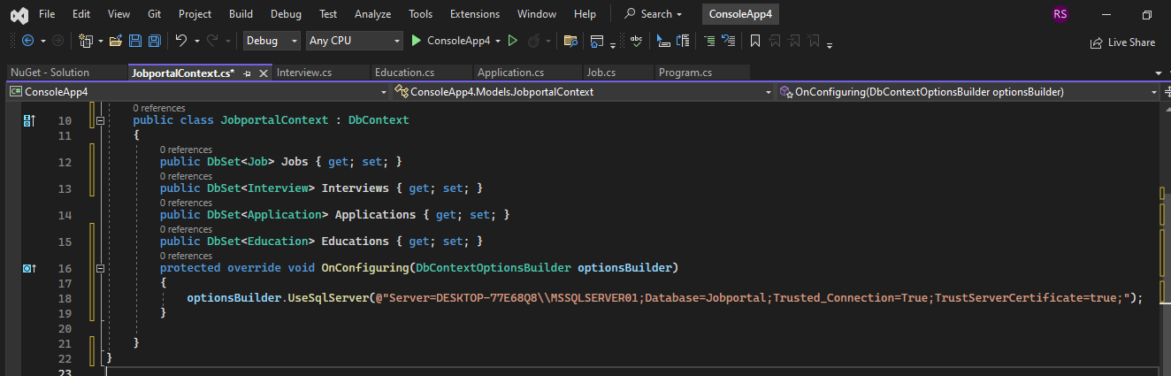
SchooJobportalContext class :
Above context class includes four DbSet<TEntity> properties, for Jobs,Applications,Interviews and Education type which will be mapped to the Jobs,Applications,Interviews and Educations tables in the underlying database.
OnConfiguring() method, an instance of DbContextOptionsBuilder is used to specify which database to use.

Slide 27
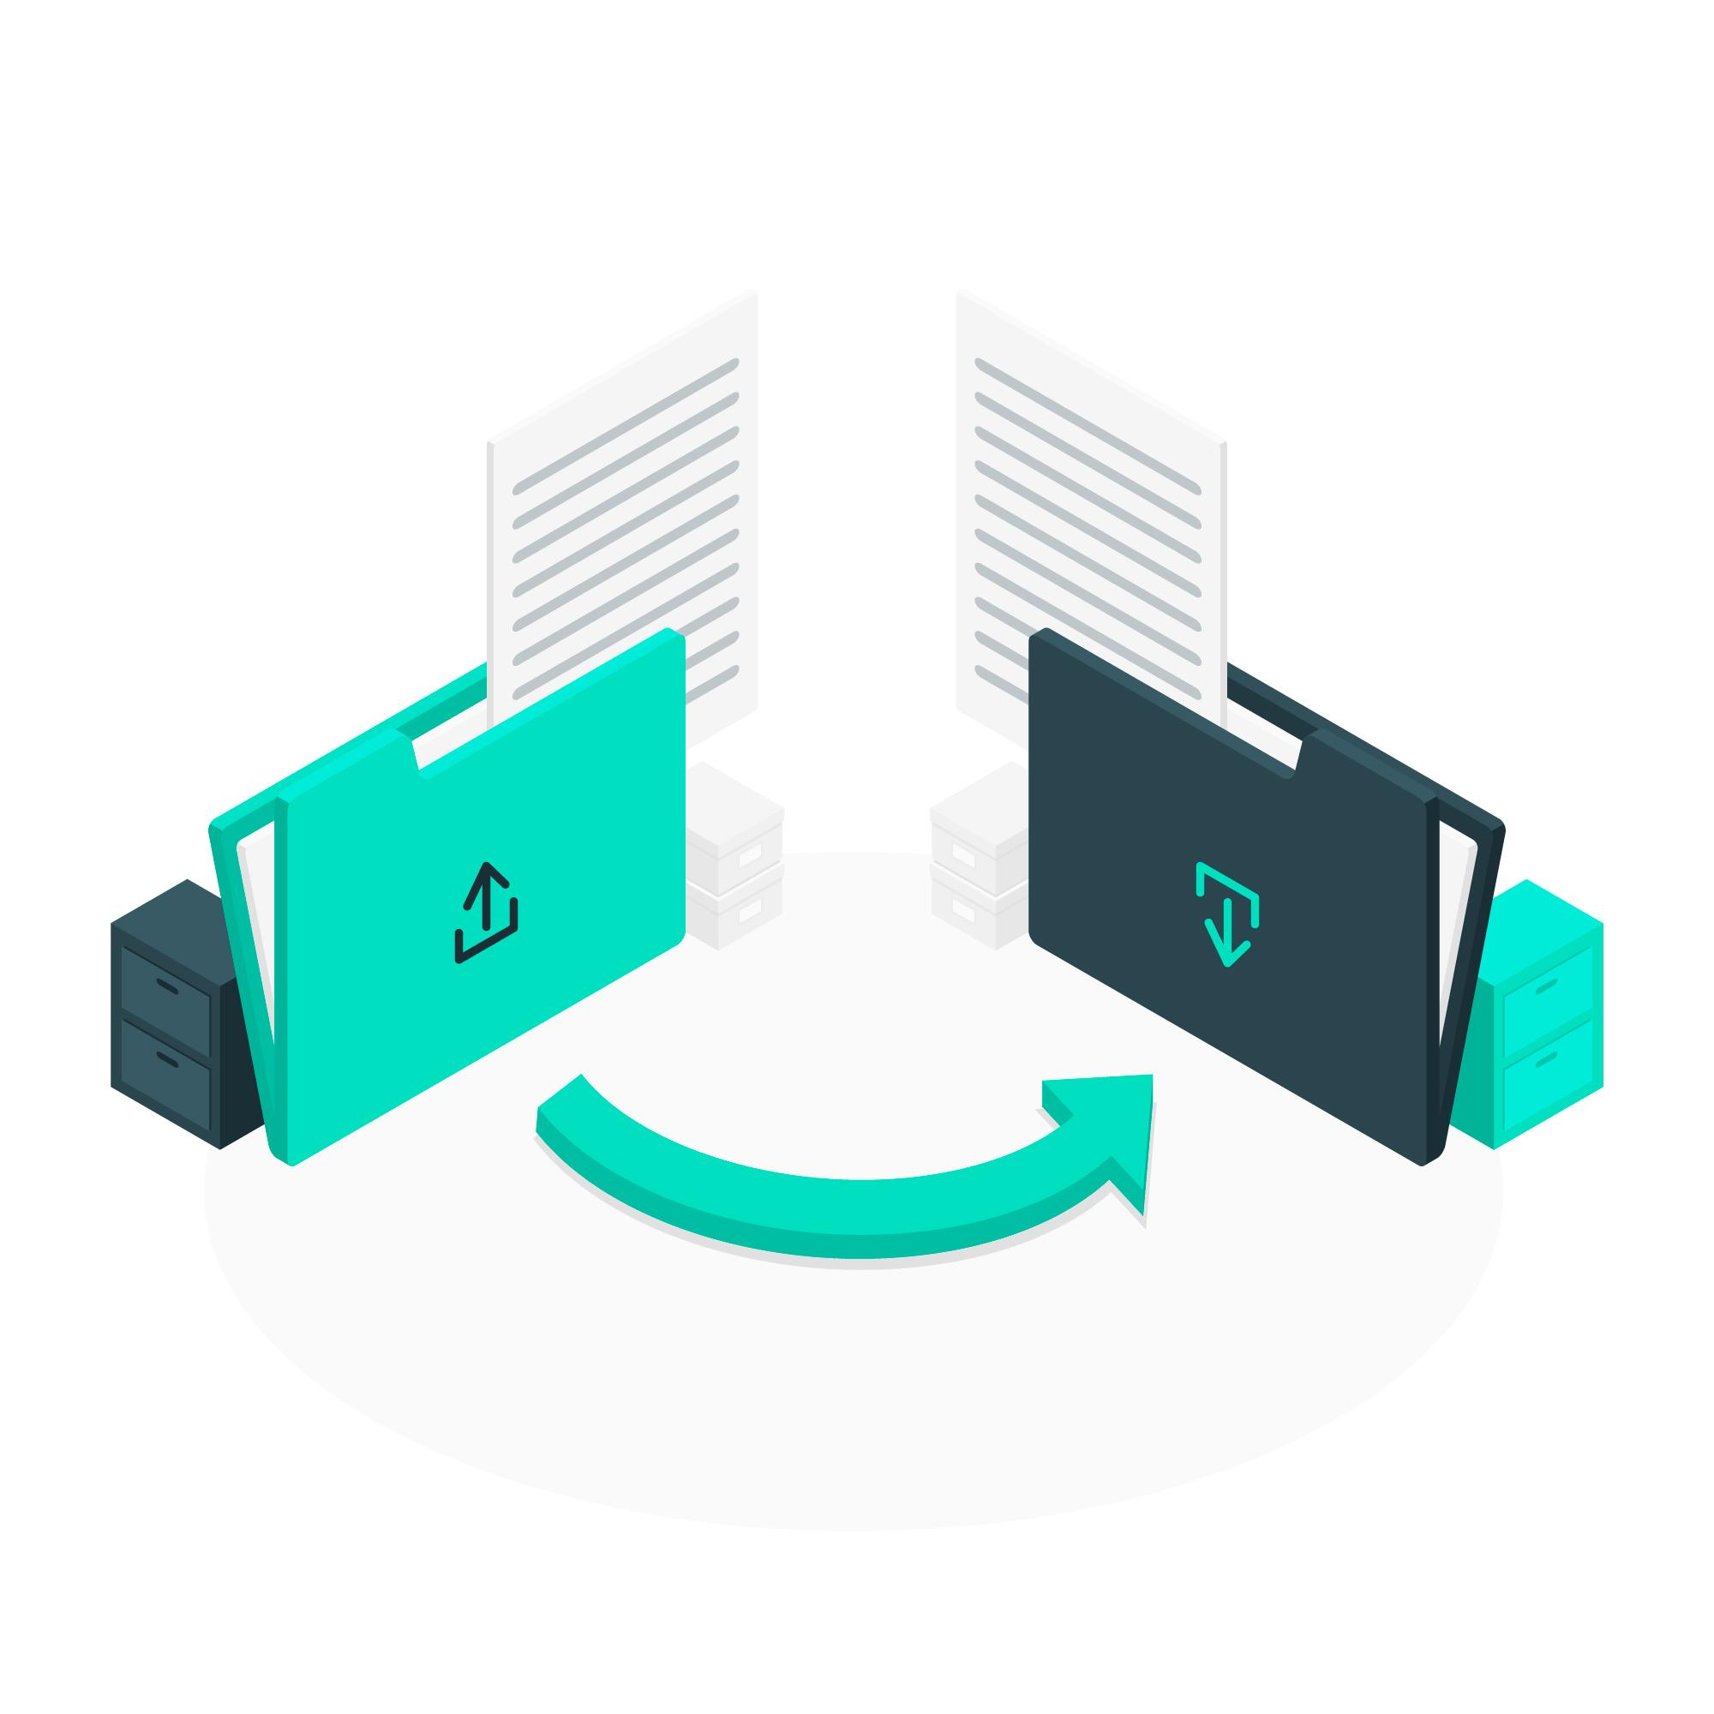
Adding a Migration
EF Core includes different migration commands to create or update the database based on the model.
We can execute the migration command using NuGet Package Manger Console

Slide 28
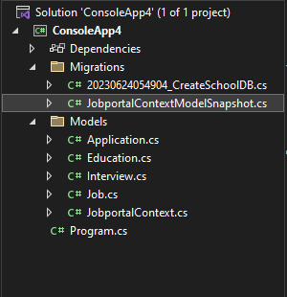
To Add Migration:
PM> add-migration CreateJobportal

Slide 29
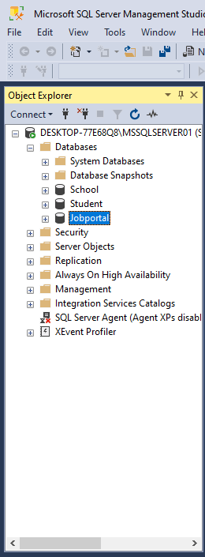
After creating a migration, we still need to create the database using the update-database
PM>update-database -Jobportal

Slide 30


